Slide 1
SNAPDRAGON 1818113 – T.Dharani 1818153 – K.Sowndarya
DCN Lab:
Experiment 3
PPT & Content by,
Dharani T (1818113)
Program by,
Sowndarya K(1818153)

Slide 2
UDP Connection
Aim:
To write a python program to implement Client Server program using UDP connection.

Slide 3
Procedure- Server:
Step 1: Import Socket module to create server socket
to receive message and address send by the client
import socket
Step 2: Mention the UDP IP address of the system and
the port number which carries the message send by the
Client.
Note:Port number should be greater than 5000.
UDP_IP_ADDRESS = “192.168.43.78”
UDP_PORT_NO = 5200

Slide 4
Step 3: Now create the Datagram socket.
serverSock= socket.socket(socket.AF_INET,
socket.SOCK_DGRAM)
Step 4: Bind the server socket with IP address and PORT address .
serverSock.bind((UDP_IP_ADDRESS,UDP_PORT_ NO))
step 5: After binding is done successfully and before the message is received from client,the server ‘ll wait for message.
print(“server is waiting”)
Step 6:once the message is received along with the address,
it will be decoded and displayed.
data, addr= serverSock.recvfrom(1024)
print("here is the client Message:",data)

Slide 5
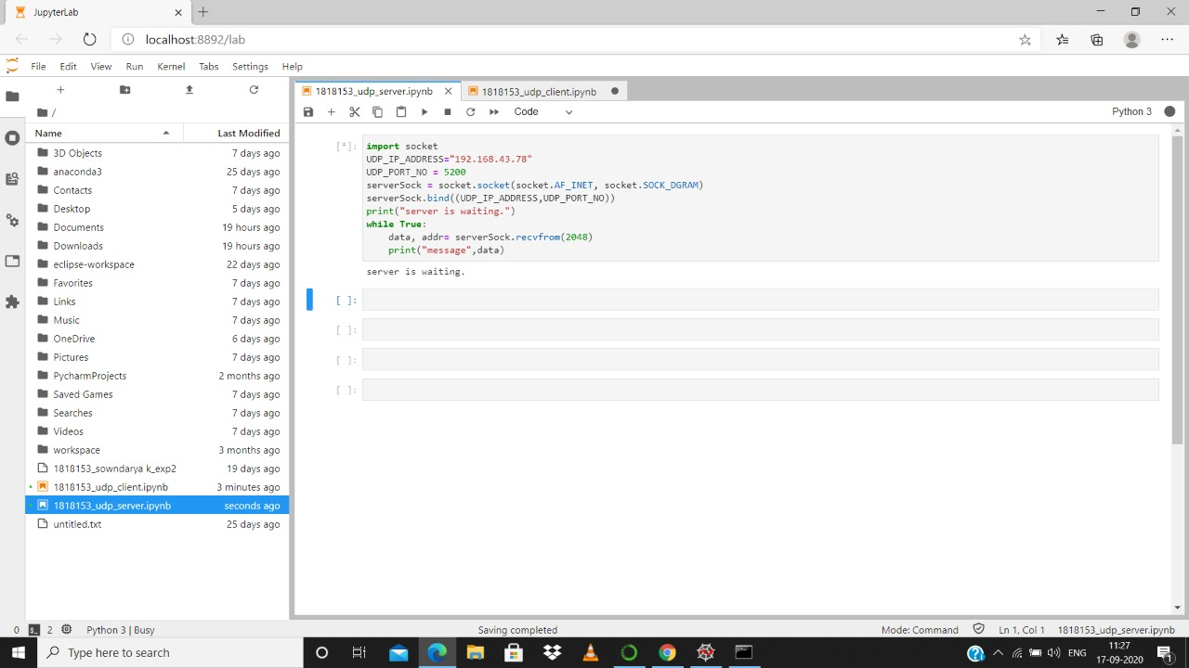

Slide 6


Slide 7
Procedure- Client:
Step 1: Import the Socket module to create a client socket for
sending message to server.
import socket
Step 2: Mention the UDP IP address and port number.
UDP_IP_ADDRESS="192.168.43.78"
UDP_PORT_NO= 5002
Step 3: Mention the message to be sent to the server and
encode it before sending.
Message="welcome everyone!“
bytesToSend=str.encode(Message)

Slide 8
Step 4: Create the UDP Datagram socket.
CLIENT = socket.socket(socket.AF_INET,
socket.SOCK_DGRAM)
Step 5: Send the Data to Server using the
created UDP socket.
CLIENT.sendto(bytesToSend,(UDP_IP_ADDRESS,
UDP_PORT_NO))

Slide 9
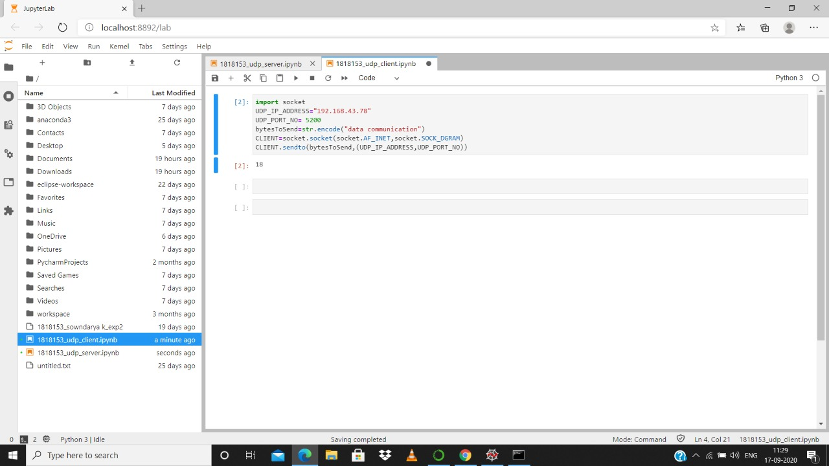

Slide 10
TERMS USED IN THIS PROGRAM
User Datagram Protocol (UDP):
UDP is a Transport Layer protocol. UDP is a part of Internet
Protocol suite, referred as UDP/IP suite. UDP (User Datagram Protocol) is a
communications protocol that is primarily used for establishing low-latency
and loss-tolerating connections between applications on the internet. It
Speeds up transmissions by enabling the transfer of data before an agreement
is provided by the receiving party.
Socket:
A socket is one endpoint of a two-way communication link between
two programs running on the network. A socket is bound to a port number so
that the TCP layer can identify the application that data is destined to be sent
to. An endpoint is a combination of an IP address and a port number.

Slide 11
Datagram socket:
A datagram socket is the sending or receiving point for a packet
delivery service. Each packet sent or received on a datagram socket is
individually addressed and routed. ... In some implementations, broadcast
packets may also be received when a DatagramSocket is bound to a more
specific address. A datagram socket provides a symmetric data exchange
interface without requiring connection establishment. Each message carries
the destination address.
Encoding :
Encoding is the process of converting the data or a given sequence
Of characters, symbols, alphabets etc., into a specified format, for the
secured transmission of data.

Slide 12
RESULT:
Thus, the python program to implement Client Server program
was executed successfully.

